Slide 1
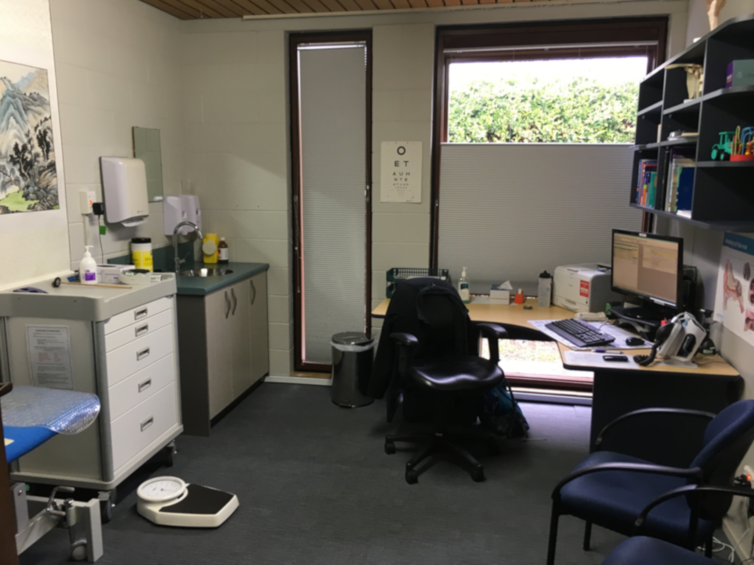
GP Triage
… Sharing our experience

Slide 2

Background
Struggling with increasing acute GP demands
Delays in routine appts adding to acute issues
Increasing “walk-in” patients
Reduced continuity of care due to different GP’s doing “acute Dr role” different days

Slide 3
Goals
Reduce acute presentations and increase proportion of routine care
Improve continuity of care for patients
Improve non-face-to-face services in order to improve local access to health care and advice
Improve health experience for our local patient population
Improve sustainability of local health-care provision

Slide 4
Context
8200 patients
Goal 5.5 GP FTE
Currently 4.1 FTE
6.3 Nurse FTE’s
Lead nurse
3-4 clinical nurses
1-2 phone nurses
Clinical Support
Reception and office staff - 5FTE’s

Slide 5
Process
Meetings
Established morning meetings “Huddles”
Allow for feedback from whole team and quick response to problems
Teams
Created “Teams”
Try to begin continuity pathways
Pilot
Piloted 1 GP doing phone triage (own pts and “away” GP pts)
Assess template function, Assess demand
Begin education of patient population
Infrastructure
Worked on infrastructure
Phonelines
Rostering templates
Start
Go live
Understand how charging for GP triage can work
Establish change team

Slide 6
Teething issues
Telephones
  Need to have sufficient lines in and out of practice to be able to call on
Booking slots for acute patients
  How to balance need for early appts with need to manage patients ringing/presenting at end of sessions
    Staggered Triage slots
    Acute Admin slots
How to share the workload – some manage phone triage better than others
How to manage costs
How to cope with varying call numbers on different days (not easy!)

Slide 7

What has worked well
Patients appreciate being called by GP
Significant proportions of our patients are being managed without needing to be seen
Having a “Day nurse” who can assess those who need assurance or further clarification of presenting problem
  Often children with URTI’s, “flu-like” adults etc
Having different amounts of triage on different days
  Monday load is significantly more than other days
Having 30 min triage slots rather than 15 min slots
  Short times feel pressured and like an interruption
Having 24/48 hr appointments available for urgent but not acute appts

Slide 8
Ongoing Challenges
Differences in triage capacity
  Challenge of keeping this service to triage and not getting caught up in consultation mode
  Challenge of protecting phone-time when running late
ACC related medical certificates
Still short-staffed – limit to how much extra capacity can be created
Continuity of care – teams don’t work so well with small numbers and multiple part-time staff
Keeping some capacity to deal with “other” things
  eg. Urgent resthome/home visits
  Availability to support nurses where they need Dr input

Slide 9
Current process
MONDAY
TUE-FRI
 | GP1 | GP2 | GP3 | GP4
830
845
900
915
930
945
1000
1015
1030
1045
1100
1115
1130
1145
1200
1230
1300
1330
1345
1400
1415
1430
1445
1500
1515
1530
1545
1600
1615
1630
1645
1700
 | GP1 | GP2 | GP3
830
845
900
915
930
945
1000
1015
1030
1045
1100
1115
1130
1145
1200
1230
1300
1330
1345
1400
1415
1430
1445
1500
1515
1530
1545
1600
1615
1630
1645
1700
Staggered GP phone times
Monday mornings have increased triage relative to Tue-Fri (120-150 min cf 90 min)
Phone-call solutions:
  See GP on day
  See Nurse on day
  Future appointment
  Recommend alternative Healthcare option
  Script/Medical certificate
  Advice

Slide 10
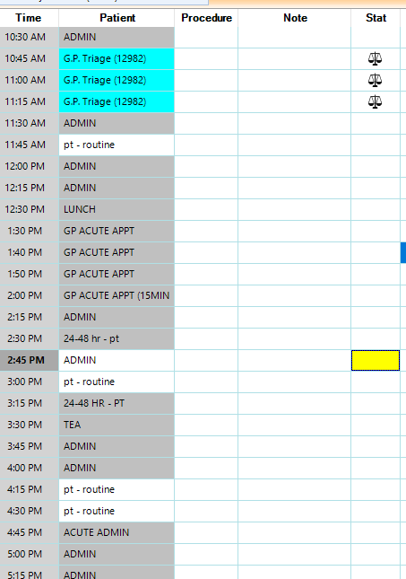
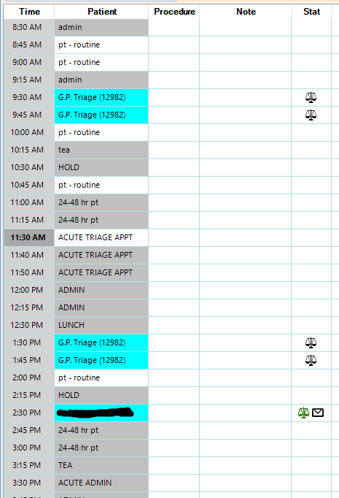
Template examples

Slide 11
Phone-call pathway
Is this a New problem or an Ongoing problem?
Ongoing problem: Can you wait to speak to the Dr you’ve previously seen?
YES. Listed on triage for specific Doctor to call
NO. Listed on triage with usual GP documented
New problem:
Secondary reception decision point
Triage allocation
Initial reception decision point
Phone-call seeking appointment today
Patient waits for specified GP to call (may not be during that triage time)
Usual GP calls own patients first
then those from team then uncalled patients
Usual GP calls own patients first
then those from team then uncalled patients
Assess: Is this call appropriate for triage?
(eg. Febrile child <3 months, chest pain/collapse etc)
Triage response
Listed on triage with usual GP documented
Inform of potential costs

Slide 12
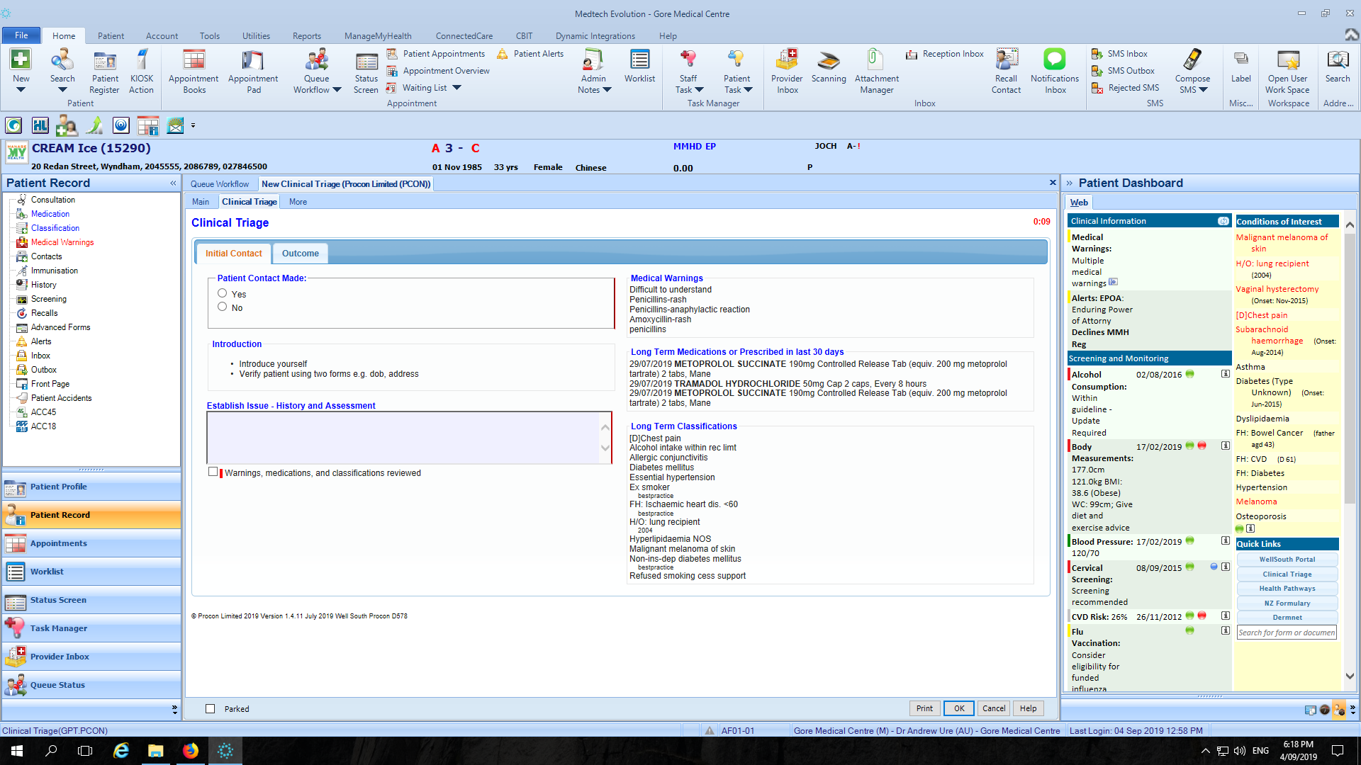

Slide 14
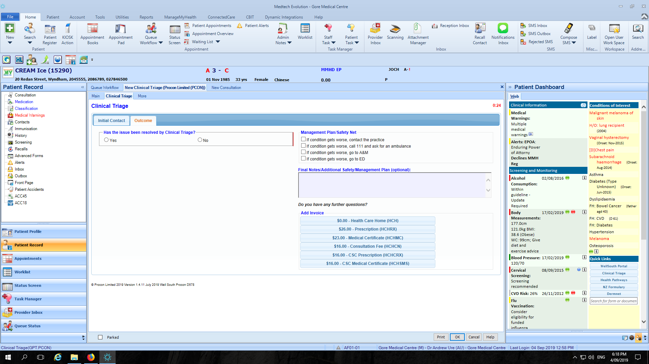

Slide 16


Goals … provisional thoughts
Reduce acute presentations and increase proportion of routine care –
Improve continuity of care for patients –
Improve non face-to-face services in order to improve local access to health care and advice -
Improve health experience for our local patient population –
Improve sustainability of local health-care provision –
Yes for acute, Not yet for routine
Not yet
Yes definitely
Yes for urgent care, routine care still not ideal
Unclear

Slide 17
Questions
1. Would we recommend GP triage if a practice has on-the-day capacity?
  Not in the way that we are doing it
    Could use modified version to offer remote service option (using phone and email)
      Email or phone book for teleconsultation
    Could use modified version of triage to improve continuity of care
2. Do we expect to quit triage when we have more GP’s?
  No … but expect it will look different.
    Cut down time set-aside to phone triage
    Increase ratio routine-to-acute appts
    Perhaps will increase time available for each triaged appointment

Slide 18
Questions
3. Do all GP’s do triage or just some?
  Not involving short-term locums (<1 month) in triage
    Don’t know patients
    Increased medicolegal risk
4. What role do nurses take who were previously doing acutes?
  Still doing some triage to cover any patients the GP’s haven’t contacted
  Still one valued pathway for triage outcomes
  More capacity for chronic care, care planning, CLIC program etc.
    Starting to utilize health-care assistants

Slide 19
Questions
5. Is it cost effective?
May 18 - $700.74/session
May 19 - $559.15 /session
June 18 - $671.87/session
June 19 – $733.26/session
July 18 - $582.28/session
July 19 - $629.38/session
Aug 18 – $503.8/session
Aug 19 - $601.83/session
$

Slide 20
Questions
6. Is it safe? What happens if I feel I need to see the patient?
  If you don’t feel comfortable dealing with condition remotely then see the patient or arrange for patient to be seen
    Definitely significant minority of patients initially treated remotely who later need review
      Feels like reducing proportion as GP’s gain skill
    Not aware of any cases yet that have had a bad outcome
7. How to engage GP’s to understand the value to patients of GP triage?
  ???? 🤔
    Consider own expectations around urgent access to care and advice, and how your practice could facilitate that ideal
    Patient feedback about experience of navigating health system
    Trial a version that seems appropriate to your situation
      Seeing the value comes with experience of it

Slide 21
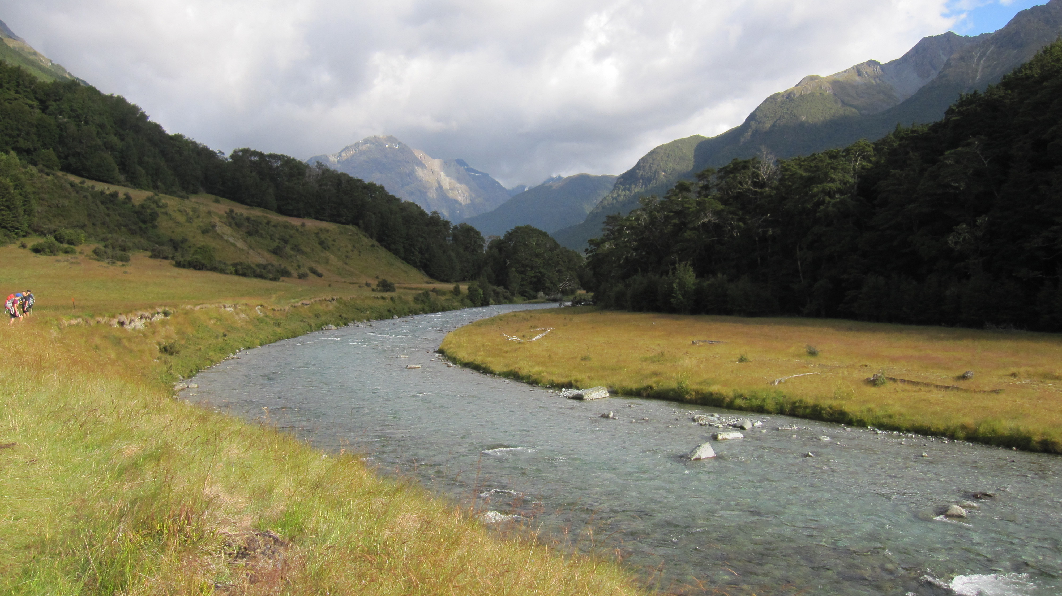
摸石过河
We cross the river by feeling the stones

