Slide 1
Insert Surgery Name Standardised Consult Room Drawers/Trolleys/Shelf
Insert logo
Large Visual Slides for stocking
Smaller Visual Slides for drawers

Slide 2
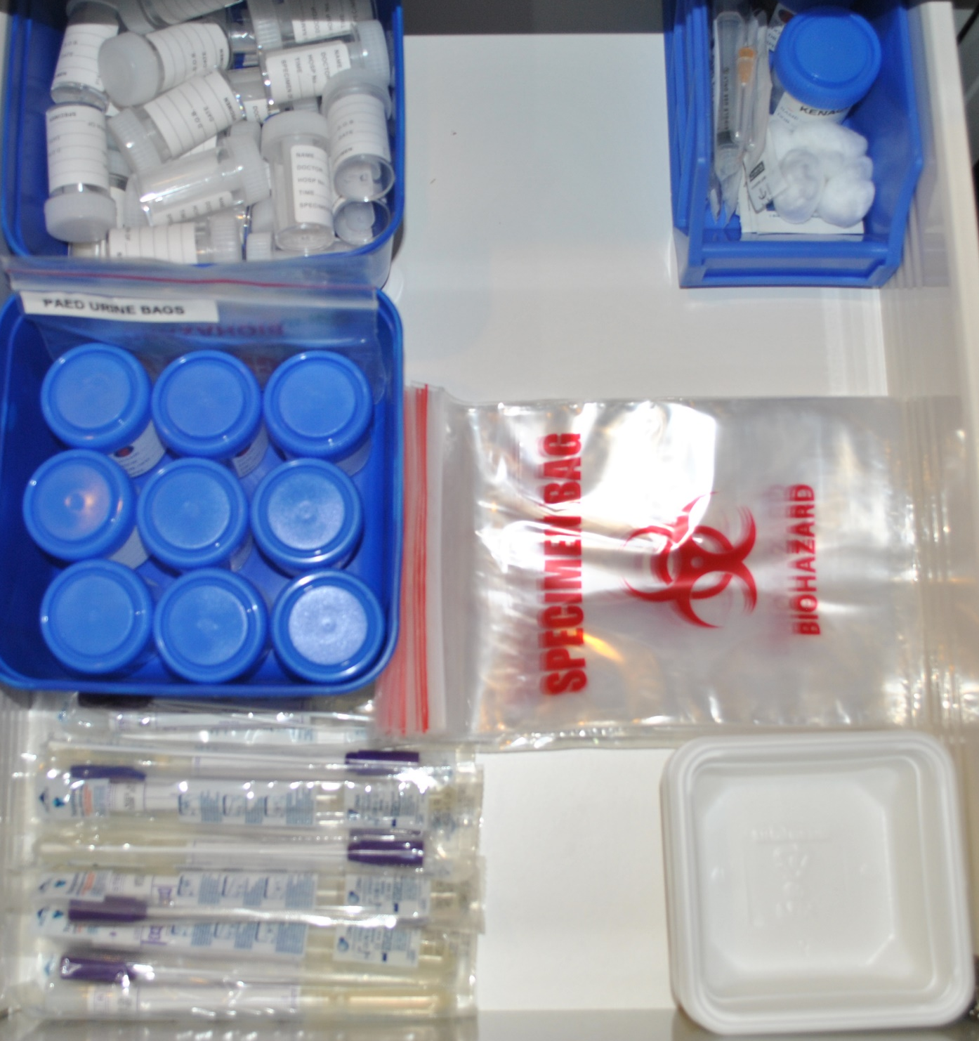
Drawer One
Steroid Injections
Betadine x1
Kenacord A-40 x 2
Cotton wool balls x 4
Plasters x 4
5ml syringe x2
Needles 22g 1 ½ inch x 2
Needles 25g 1 inch x 2
Alcohol swab x4
Faeces pottles
¾ fill
Paed Urine bags x 3
Paed Urine bags x 3
Speciman bags x 20
Urine pottles x 9
Strawberry punnet x 10
Vaginal swabs x 10

Slide 3
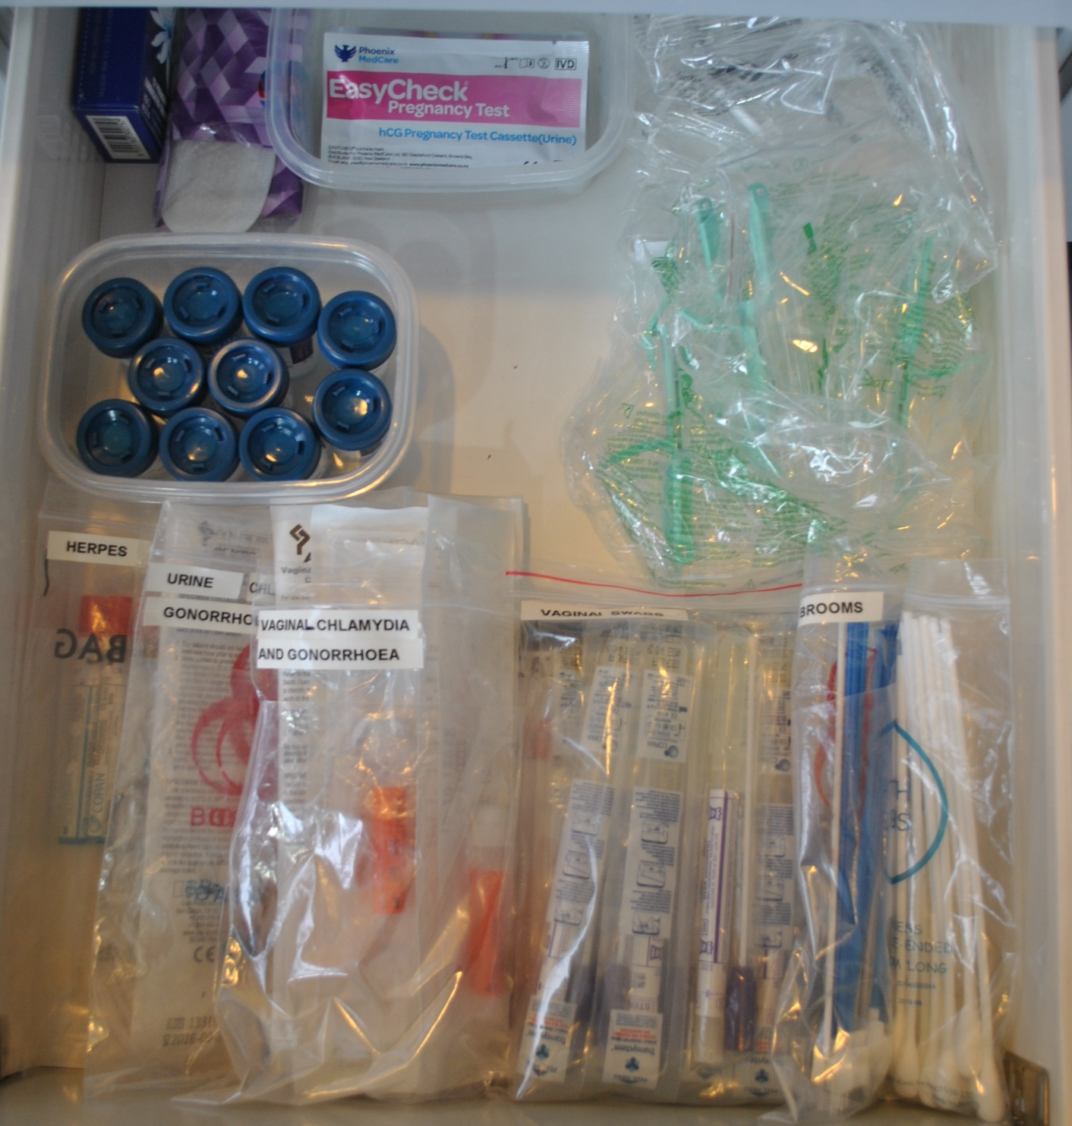
Drawer Two
Pregnancy Test x 4
Box of condoms x 1
Speculum S x2
Panty Liners x 4
Speculum M x5
Thin Preps x 10
Herpes x 2
Urine Chlamydia + Gonorrhoea x 2
Vaginal Chlamydia x 8
Vaginal Swabs x 10
Brooms x 10 & Brushes x 5
Jumbo Swabs x 10

Slide 4
Drawer Three
Measuring Tape x1
Patient Peak flow meters
Low range x 1
Medium range x 1
Spacers x 4
Monofilament
Child Masks x 2
Demo Peak flow meters
Low range x 1
Medium range x 1
Mouth pieces (full)
Asthma wheel x 1

Slide 5
All Drawers
These visuals were essentially designed to be printed in colour, laminated and cut to size so that they fit inside the drawers of the consult rooms
Faeces pottles
¾ fill
Drawer One
Steroid Injections
Betadine
Kenacord A-40 x 2
Cotton wool balls x 4
Plasters x 4
5ml syringe x2
Needles 22g 1 ½ inch x 2
Needles 25g 1 inch x 2
Alcohol swab x4
Panty Liners x 4
Drawer Two
Speculum S x2
Spacers x 4
Drawer Three
Patient Peak flow meters
Low range x 1
Medium range x 1
Measuring Tape x1
Box of condoms x 1
Pregnancy Test x 4
Paed Urine bags x 3
Monofilament
Speculum M x5
Thin Preps x 10
Child Masks x 2
Demo Peak flow meters
Low range x 1
Medium range x 1
Urine pottles x 9
Speciman bags x 20
Herpes x 2
Urine Chlamydia + Gonorrhoea x 2
Vaginal Chlamydia x 8
Vaginal Swabs x 10
Brooms x 10 & Brushes x 5
Jumbo Swabs x 10
Vaginal swabs x 10
Strawberry punnet x 10
Mouth pieces (full)
Asthma wheel x 1

Slide 6
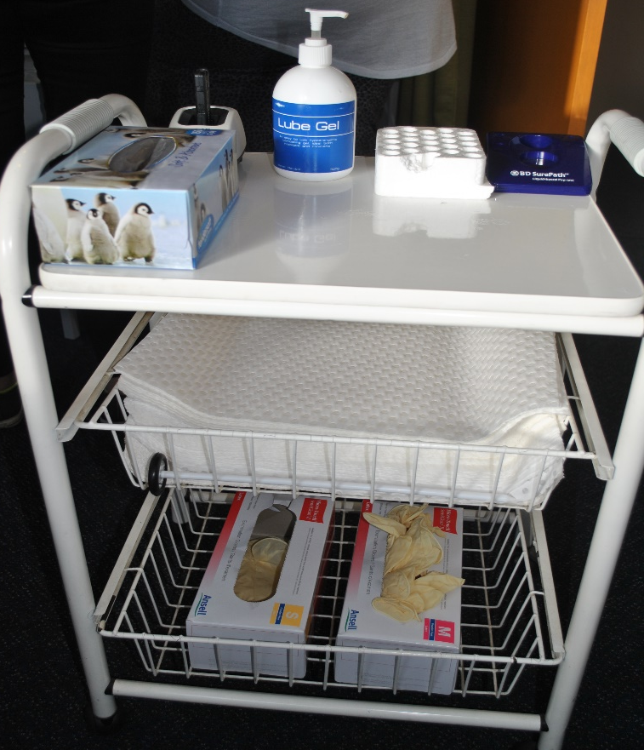
Trolley & Shelf
These visuals were essentially designed to be printed in colour, laminated and cut to size so that they fit inside the drawers of the consult rooms
Trolley Layout
Insert Shelf Layout
*Couch covers are kept in drawers under the bed
Light Source x 1
Thin Prep holder x 1
Lubricant bottle x 1
Test Tube holder x 1
Tissues x 1
Couch Covers
Gloves – small x 1 box
Gloves – medium x 1 box

Slide 7
Trolley
Lubricant x 1 bottle
Light Source x 1
Test Tube holder x 1
Thin Prep holder x 1
Tissues x 1 box
Couch Covers
Gloves – small x 1 box
Gloves – medium x 1 box

