Slide 1
Open Notes
and
Electronic Health Records
Notes:
Introduce myself
Talk about things we are going to cover
Concerns/ safety
Feedback from patients
Mental health and open notes
Set up
Policies
How to write open notes
“do not upload to MMH”
Lots of information from the States where big Open Notes movement ( most litigous place)
Also college advice “ nothing written about me that’s “

Slide 2
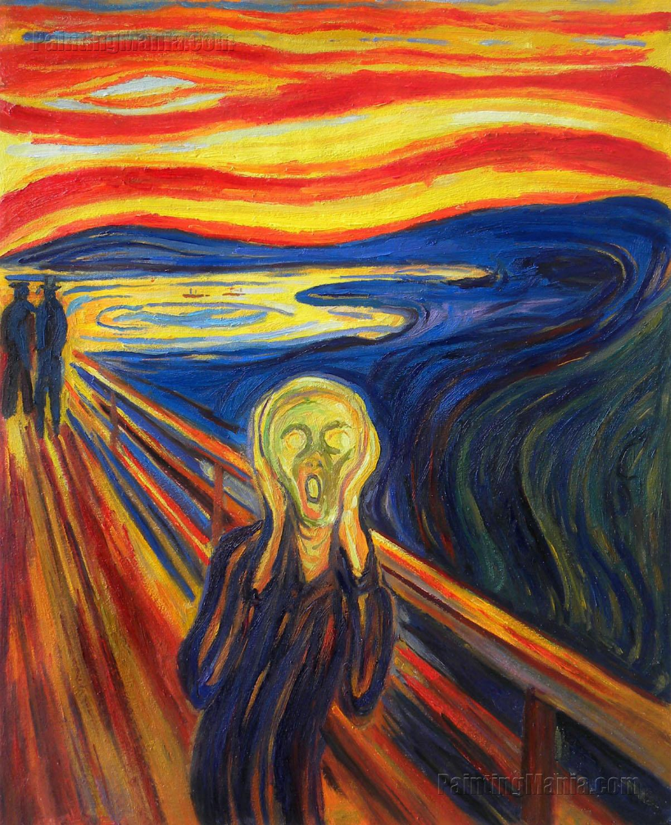
Notes:
I hear you all silently screaming
What are your concerns? – ask audience
Medico legal worries
Taking more time
Change the way I write notes
Upsetting patients
complaints

Slide 3
A Strong Case for Sharing
The evidence is building steadily. Sharing notes can help you improve communication with your patients, build stronger, more trusting relationships, and enhance patient safety, without adding to your workload.
Notes:
Study Highlights: ( various)
77-87% of patients said open notes helped them feel more in control of their care.
60-78% of those taking medications reported better adherence.
85% of patients said they would choose a health professional based on the availability of open notes

Slide 4
The Law
Patients have the right to read their clinical notes
Rule 6 of the Health Information Privacy Code (HIPC) grants all individuals (no age limit applies) a right of access to information held about them by a health agency with limited exceptions.
Section 22F of the Health Act 1956 and rule 11(4) (b) of the HIPC entitles an individual’s representative to request access to their health information, where the individual is under 16 years of age.
Notes:
Speak about case and advice given to me from MPS where most notes would be released to patient.
There are circumstances in which the request for access may be refused, but these are exceptional cases. Where the request for access is made by the individual concerned, the only valid reasons for refusal are those set out in the Privacy Act. These include situations where disclosure would prejudice the maintenance of law, endanger the safety of any individual, involve the unwarranted disclosure of the affairs of another individual, prejudice the physical or mental health of that individual, or would be contrary to the individual’s interest (where the individual is under 16).⁴
The rights of access within the Privacy Act and the HIPC will also override any other obligations of confidentiality or privilege owed to a third party who provided the information.⁵ Any practitioner making records or collecting information about an individual should do so with the presumption that they will be seen by the individual concerned.

Slide 5
New opportunities for efficiency
Improved accuracy and safety
Adherence to medication and treatment plans
Better chronic disease management
Advantages
Stronger relationships and better engagement
Support for carers helping your patients

Slide 6
Safety
BMJ: When doctors share visit notes with patients: a study of patient and doctor perceptions of documentation errors, safety opportunities and the patient–doctor relationship
Notes:
Conclusions Despite concerns about errors, offending language or defensive practice, transparent notes overall did not harm the patient–doctor relationship. Rather, doctors and patients perceived relational benefits. Traditionally more vulnerable populations—non-white, those with poorer self-reported health and those with fewer years of formal education—may be particularly likely to feel better about their doctor after reading their notes. Further informing debate about OpenNotes, the findings suggest transparent records may improve patient satisfaction, trust and safety

Slide 7
Compliance
A study published in 2012, up to 78% of patients reported that open notes helped them take their medications as prescribed.
In interviews and focus groups with patients and families we have gathered considerable evidence supporting these survey findings.
More recently, a study by the Geisinger Center for Health Research found that patients offered access to notes were more likely to fill their prescriptions for blood pressure medication

Slide 8
Chronic Disease Management
Better understanding of chronic conditions
Enhanced recall
Share information with Whanau, carers and specialists
Can see management plans
See changes in medication

Slide 9
Health Literacy
JAMA: Patients, care partners, and shared access to the patient portal: online practices at an integrated health system
Discussion and Conclusion Shared access is an underused strategy that may bridge patients’ health literacy deficits and lack of technology experience and that helps but does not fully resolve concerns regarding patient and care partner identity credentials.

Slide 10
Open Notes and Mental Health
In 2014, Kahn and colleagues suggested that open notes could be a valuable therapeutic intervention for managing mental/behavioral health and illness in many patients. They argued that the benefits of sharing psychiatric notes with patients, including those focusing on psychotherapy, could well outweigh widely anticipated risks.
Clinicians worry that sharing notes with patients will require changing the way they work, and that reading notes will make patients worried, confused, or angry. These concerns especially in mental health
Notes:
Open notes hold promise for helping the therapeutic process, as well as reducing the stigma of mental health and illness. Sharing notes can build trust, making patients feel more understood by social workers, psychiatrists, and others on the health care team. Such connection can enhance patients’ willingness to address mental health issues more actively. Some psychotherapists say that inviting patients to see their issues in writing can catalyze behavior change more effectively than discussion alone. Using notes as an integral component of therapy is attracting considerable interest among mental health professionals and their patients. Formal studies are now under way, and we hypothesize that they’ll show that open notes have a positive impact.

Slide 11
Potential benefits in Mental Health
Demonstrating respect
Reducing stigma
Empowering patients
Organising and tracking progress
Tool for behaviour changes
Enhancing trust
Safer care especially around medication and compliance
Reduced workload

Slide 12
New Opportunities for Efficiency
Workload
Time Management
Time saved for patients
Notes:
You may well worry that sharing notes will add to your workload and time pressures. The evolving literature and experience says otherwise. In one study, fewer than 5% of doctors reported spending more time addressing patient’s questions outside of visits, and most reported not changing the way they wrote notes. Indeed, most of those who adjusted their writing felt they improved their notes. We have not received complaints of having to “dumb down” notes, thereby impairing communication with colleagues. What’s more, patients who read their notes are more likely to be engaged between visits, and may arrive at their next visit better prepared. In the future, allowing patients to contribute to the record, including updating the family and social history, writing a concise, structured interval history, and proposing a visit agenda, could off-load work during a visit and free up time, which could prove mutually beneficial.

Slide 13
Implementing open notes
Pilot program? Handing patient notes after a consultation?
What notes will you share? .
Choose if retrospective or from certain date.
Develop guidelines for when clinicians have the ability to keep a note ‘private’ (though our experience is that fewer than 1% of notes are hidden, and the percentage drops over time as health professionals and patients gain comfort with the new practice). In such cases, it’s important to communicate with patients about such decisions.
It’s also important to develop a workflow to manage patients’ requests to change or amend their notes. NOTE: Very few patients contact the clinician’s office about something in the note, but among those who do, nearly 30% discovered an error in the record, suggesting an opportunity to improve safety.
Prepare your team
Make patients aware of the changes
Notes:
Only people registered for MMH will be able to see their clinical notes
Make sure once switched on they are visible- experience
Guidelines for restricting notes- word docment

Slide 14
Documentation Principles
Use specific language and avoid vague words and generalisations
Complete notes with information related to patient condition and care plan
Be objective and avoid judgemental or critical words
Be timely with writing notes
Notes:
Be specific: Reflect factual information/use factual statements/ if unsure of diagnosis identify it as speculation in notes. If unsure consider using do not upload ( ? Use separate note)
Be Complete: Notes contain all information
Be Objective: avoid judgemental terms. Use “ declined instead of “ refused” , Use “adherence” instead of compliance, “BMI instead of fat” , Use “untucked shirt” instead of dishevelled.
Avoid extraneous remarks- don’t make humorous or friendly remarks . Don’t use arguing/belittling/critising or blamng another’s care decisions. When different opinions occur more productive to discuss with the patient and leave the medical record to objective documentation
Do not enter: Incident reports or complaints as these are confidential / do not comment on fees etc

Slide 15
Specific Suggestions for Writing Notes
Difficult conversations: If it’s important enough to put in the note, it’s important enough to talk about. Knowing that ‘you’re on the same page’ can improve trust and the relationship.
Avoid jargon, acronyms, and abbreviations: Avoid to much jargon and abbreviations, especially those that might easily be misinterpreted by your patients. Patients do expect to see some medical jargon in their records
Offer a balanced perspective: For mental health issues in particular, describe the patient’s strengths and achievements along with documenting clinical problems. This can help the patient gain a broader context within which to consider illness and tackle difficult behavioral changes.

Slide 16
Summary
Discussion within practice.
Develop policy and guidelines
Develop implementation plan
Possibly run a pilot scheme
Advertisement ahead of time
Promote transparency- discuss with patients
Avoid medical jargon- use understandable language
Plan language- aware of “bad phrases”
Develop options of more risk than benefit/ invite reading notes together. Protect against abuse
Discuss diagnosis before adding

Slide 17
Policy for documentation principles
Guidelines for restricting notes
https://www.opennotes.org/story/chronic-conditions/
https://www.opennotes.org/story/mental-health/

